Slide 1
Weekly Update #3
Gijs Admiraal

Slide 2
Layout
Quick recap
Gloss over slides from previous 2 weeks
Thesis deadlines

Slide 3
Recap from previous weeks
Started exploring topics: atom-by-atom generation, non-standard amino acids (nsAA), (chemical) language models and data augmentation
Summarized “Atom-by-atom protein generation and beyond with language models” and contacted author
Started exploring SMILES trough RDKit tutorial
Created a mind map
Went on holiday to Stockholm

Slide 4
1st week

Slide 5
What I have done
Read and summarized the paper “Atom-by-atom protein generation and beyond with language models”
Created a small mind map
Looked at some other interesting papers
A. Kirschning (2022) - On the Evolutionary History of the Twenty Encoded Amino Acids
J.B. Ingraham et al. (2023) - Illuminating protein space with a programmable generative model
D. Flam-Shepherd et al. (2022) - Language models can learn complex molecular
Started on a RDKit tutorial
Made a question document

Slide 6
What I have done
Read and summarized the paper “Atom-by-atom protein generation and beyond with language models”
Created a small mind map
Looked at some other interesting papers
A. Kirschning (2022) - On the Evolutionary History of the Twenty Encoded Amino Acids
J.B. Ingraham et al. (2023) - Illuminating protein space with a programmable generative model
D. Flam-Shepherd et al. (2022) - Language models can learn complex molecular
Started on a RDKit tutorial
Made a question document

Slide 7
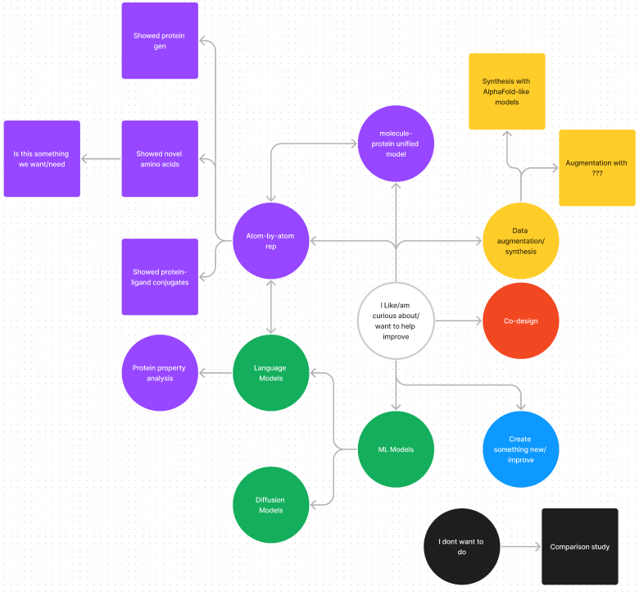
Mind map

Slide 8
What I have done
Read and summarized the paper “Atom-by-atom protein generation and beyond with language models”
Created a small mind map
Looked at some other interesting papers
A. Kirschning (2022) - On the Evolutionary History of the Twenty Encoded Amino Acids
J.B. Ingraham et al. (2023) - Illuminating protein space with a programmable generative model
D. Flam-Shepherd et al. (2022) - Language models can learn complex molecular
Started on a RDKit tutorial
Made a question document

Slide 9
What I have done
Read and summarized the paper “Atom-by-atom protein generation and beyond with language models”
Created a small mind map
Looked at some other interesting papers
A. Kirschning (2022) - On the Evolutionary History of the Twenty Encoded Amino Acids
J.B. Ingraham et al. (2023) - Illuminating protein space with a programmable generative model
D. Flam-Shepherd et al. (2022) - Language models can learn complex molecular
Started on a RDKit tutorial
Made a question document

Slide 10
What I have done
Read and summarized the paper “Atom-by-atom protein generation and beyond with language models”
Created a small mind map
Looked at some other interesting papers
A. Kirschning (2022) - On the Evolutionary History of the Twenty Encoded Amino Acids
J.B. Ingraham et al. (2023) - Illuminating protein space with a programmable generative model
D. Flam-Shepherd et al. (2022) - Language models can learn complex molecular
Started on a RDKit tutorial
Made a question document

Slide 11
2nd week

Slide 12
What I have done
Explored non-standard amino acid (nsAA) generation
Found existing research with nsAA created in wet labs but research does not include cs background
“Xenobiology in synthetic biology: From non-standard amino acid incorporation to biosecurity implications”
Verifying is hard since no dataset/benchmark exists and can’t use AF2-like methods
Thus, determined that for me is not a right path to pursue
Explored LMs for protein design
Have not found an LM that can do structure prediction only structure property prediction
Explored data augmentation for protein sequences
“Improving generalizability of protein sequence models with data augmentations”
Uses self-supervised and contrastive learning
“Nucleotide augmentation for machine learning-guided protein engineering”
More focused on nucleotide augmentation
Send email to Flam-Shepherd
Follow up + code available early next year
Open for both a meeting or my questions document

Slide 13
What I have done
Explored non-standard amino acid (nsAA) generation
Found existing research with nsAA created in wet labs but research does not include cs background
“Xenobiology in synthetic biology: From non-standard amino acid incorporation to biosecurity implications”
Verifying is hard since no dataset/benchmark exists and can’t use AF2-like methods
Thus, determined that for me is not a right path to pursue
Explored LMs for protein design
Have not found an LM that can do structure prediction only structure property prediction
Explored data augmentation for protein sequences
“Improving generalizability of protein sequence models with data augmentations”
Uses self-supervised and contrastive learning
“Nucleotide augmentation for machine learning-guided protein engineering”
More focused on nucleotide augmentation
Send email to Flam-Shepherd
Follow up + code available early next year
Open for both a meeting or my questions document

Slide 14
What I have done
Explored non-standard amino acid (nsAA) generation
Found existing research with nsAA created in wet labs but research does not include cs background
“Xenobiology in synthetic biology: From non-standard amino acid incorporation to biosecurity implications”
Verifying is hard since no dataset/benchmark exists and can’t use AF2-like methods
Thus, determined that for me is not a right path to pursue
Explored LMs for protein design
Have not found an LM that can do structure prediction only structure property prediction
Explored data augmentation for protein sequences
“Improving generalizability of protein sequence models with data augmentations”
Uses self-supervised and contrastive learning
“Nucleotide augmentation for machine learning-guided protein engineering”
More focused on nucleotide augmentation
Send email to Flam-Shepherd
Follow up + code available early next year
Open for both a meeting or my questions document

Slide 15
What I have done
Explored non-standard amino acid (nsAA) generation
Found existing research with nsAA created in wet labs but research does not include cs background
“Xenobiology in synthetic biology: From non-standard amino acid incorporation to biosecurity implications”
Verifying is hard since no dataset/benchmark exists and can’t use AF2-like methods
Thus, determined that for me is not a right path to pursue
Explored LMs for protein design
Have not found an LM that can do structure prediction only structure property prediction
Explored data augmentation for protein sequences
“Improving generalizability of protein sequence models with data augmentations”
Uses self-supervised and contrastive learning
“Nucleotide augmentation for machine learning-guided protein engineering”
More focused on nucleotide augmentation
Send email to Flam-Shepherd
Follow up + code available early next year
Open for both a meeting or my questions document

Slide 16
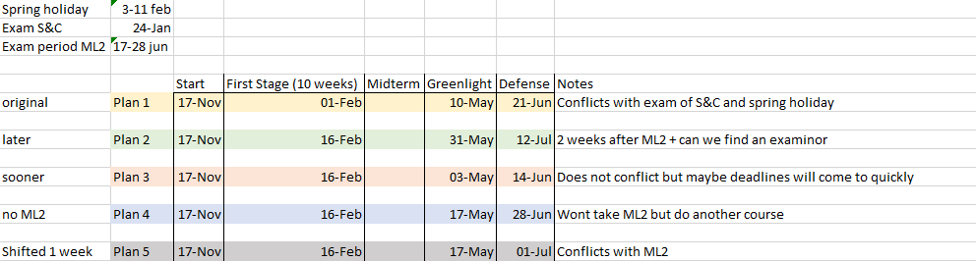
How to schedule thesis deadlines

Slide 17
Next week?
Investigate topics
LM for protein design
Data augmentation
Co-design

Slide 18
notes

